Slide 1
Divines slide

Slide 2
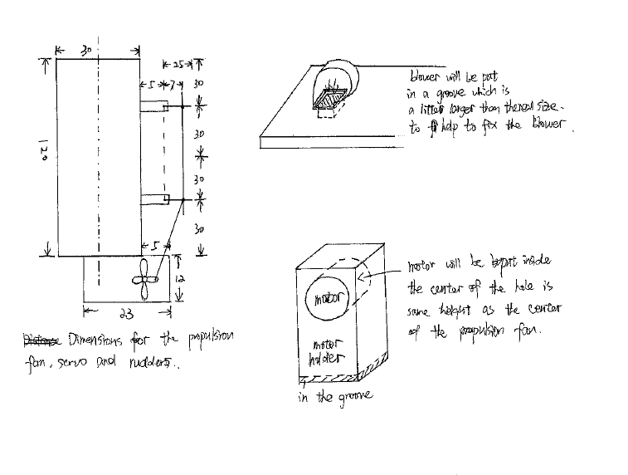
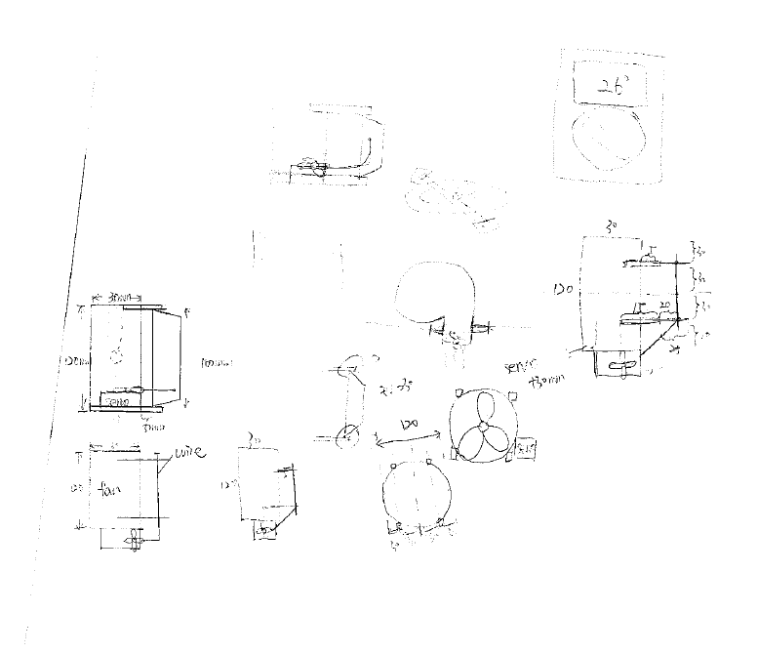
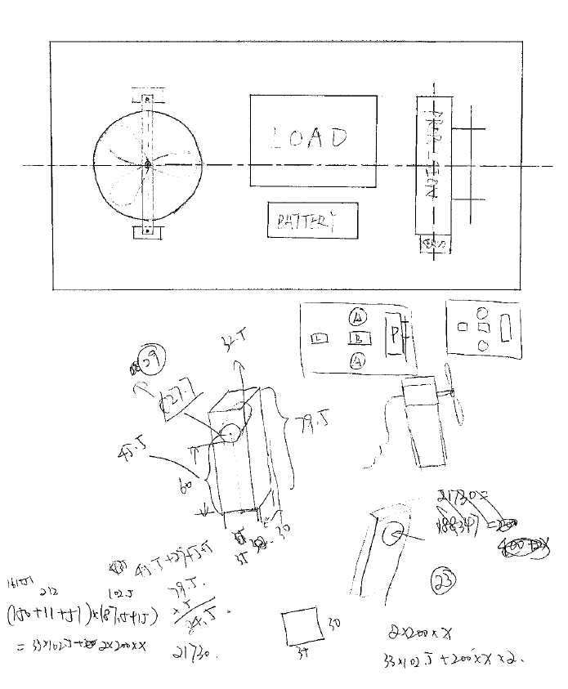
Xiang Zhang – Payload Engineer, sketches

Slide 3
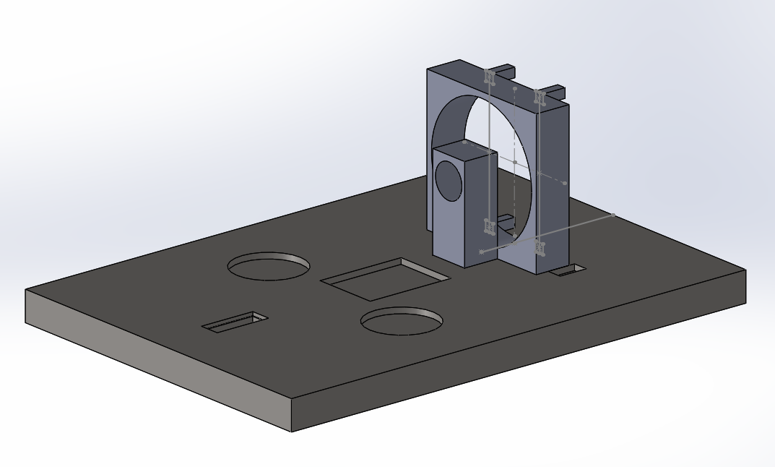
Payload – Final Design
XIANG ZHANG- Payload Engineer
The load areas are placed symmetrically about the center line of the hovercraft.
Grooves are provided for the lift fan, load, servo, motor holder and battery to be fixed to them.
All of the extruded cut should be larger than the actual components to fix them.
Servo is on one side of the propulsion fan.
Four support sticks will be placed behind the propulsion fan to fix the rudders.
Propulsion fan case
Support stick
Battery area
motor holder
Load area
servo area
Lift fan area
CALCULATIONS
All of the apparatus are vertically symmetrical about the centre line except for the servo.
Horizontally symmetric---left hand side moment=right hand side moment
(150+11+51)*(87.5+15)=33*102.5+200*x+200*x(x=position of the load)
X=46mm
The load area should be placed 23mm away from the centre point to balance the hovercraft.
Name | Length x width x thickness/mm | Weight/g
Payload area | 415 x 292 x 25 | 340(without load)
Battery | 74 x 55 x 20 | 145
Lift | 75 x 75 x 15.4 | 33
Propulsion | 100 x 100 x 25 | 150
servo | 23 x 12 x 27 | 11
Load | 57 x 57 x 11.5 | 200
motor | 27.7 x 27.7 x 47 | 51

Slide 4
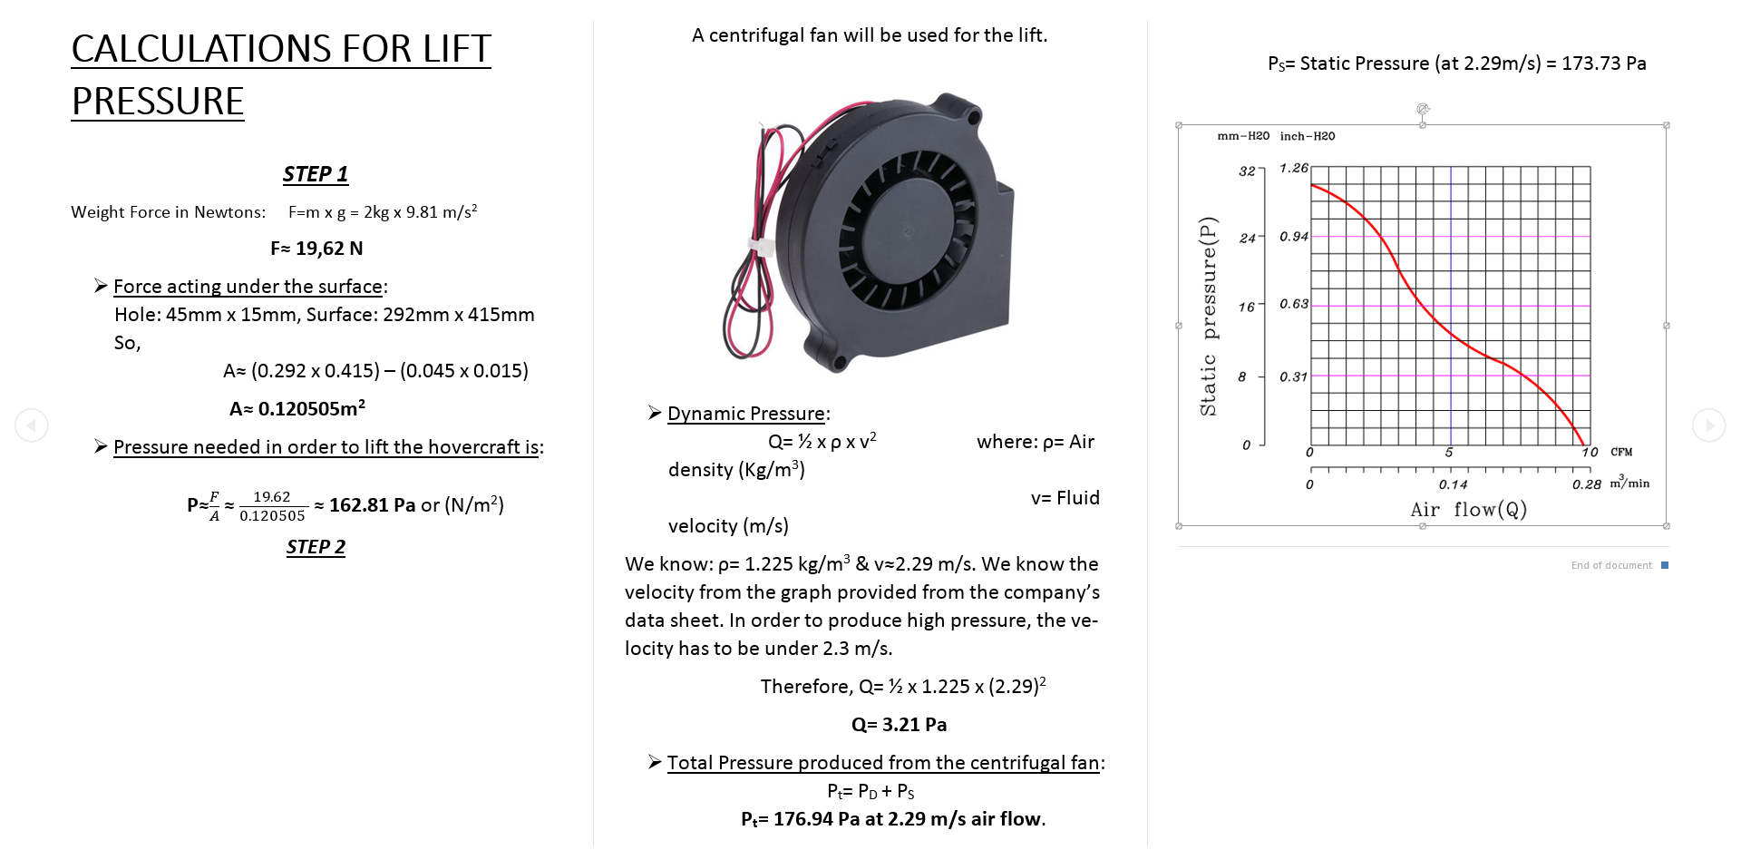
Alexandros Iakovos Agrafiotis

Slide 5
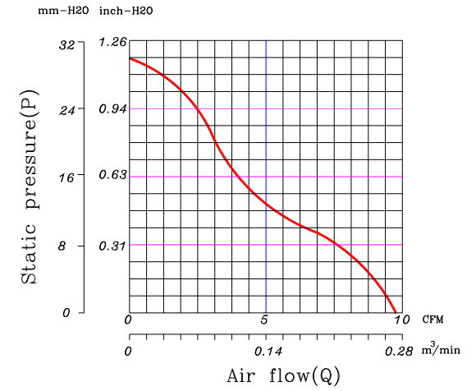
Fans-Materials & Total Cost
Alexandros Iakovos Agrafiotis – Design Engineer
Axial Fan, Centrifugal Fan & Material Selection
Basic material is going to be the Craft foam Blue because it is thick (25mm) strong enough for not breaking with the load and it is very light. Also, easy to change the shape. Cost is £12/ m² .
A centrifugal fan is going to be used for the lift as it needs low power to produce high pressure.
An axial fan is going to be used for the thrust of the hovercraft as it produces high air flow and it needs low power in order to work efficiently.
The total cost of the hovercraft is going to be around £130
Diagram 1- Static Pressure versus Air flow
Calculations Pressure needed to lift a hovercraft for A3 size around 2kg is : P= F/A = 162.81 Pa
Where F= m x g =19.62 & A= size A3 – hole of fan = 0.120505 m² In order to produce the pressure needed we will need low air flow under 2.29 m/s. That means the total pressure is the Static Pressure and the Dynamic Pressure: P_{t} = P_{s} + P_{d} = 173.73 + 3.21= 176.97 Pa Where P_{d} = ½ x ρ x v² = 3.21 Pa
We are not able to calculate the air flow and thrust from the Axial Fan as it is going to be with custom blades and a motor that produces 7800 rpm.
Centrifugal Fan (Lift) Specifications
Rated Voltage | 12V | 7V Min.
Rated Current | 0.46 Amp | 0.55 Amp Max.
Rated Power | 5.52 W | At 12V
Speed | 4500RPM | ±10%
Dimensions | L × W × H (mm) | 75 × 75 × 15.4
Weight | 55 grams | -

Slide 6
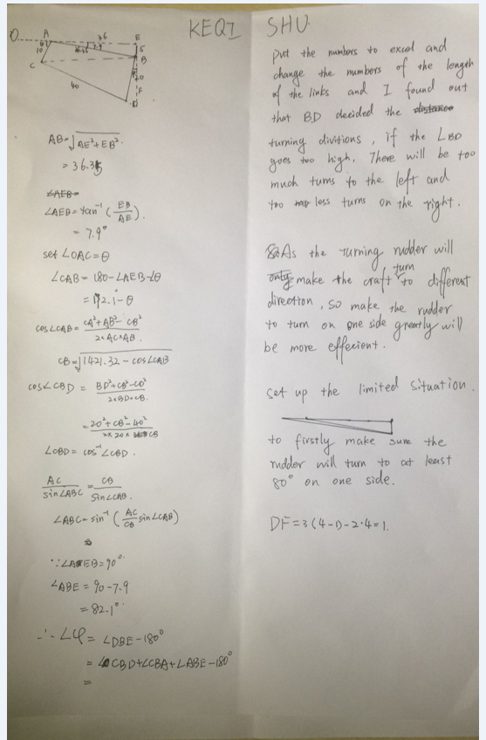
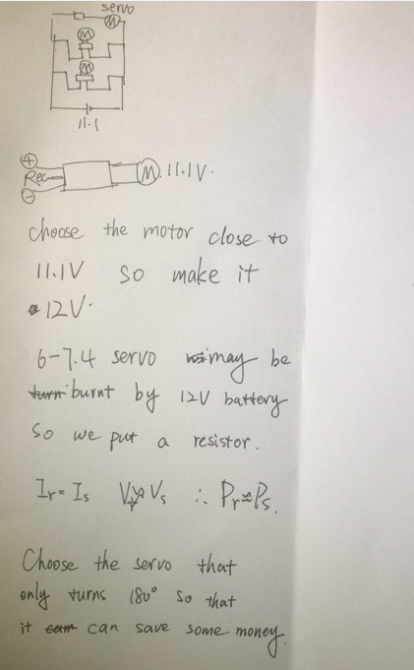
Notes
Keqi Shu- Powertrain Engineer

Slide 7
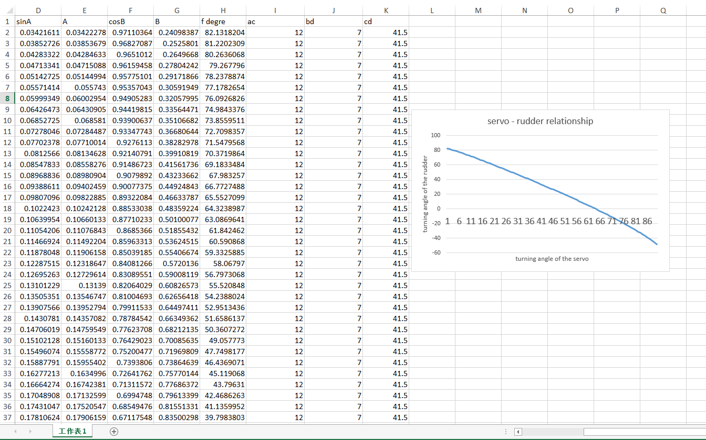
Calculations
Keqi Shu- Powertrain Engineer

Slide 8
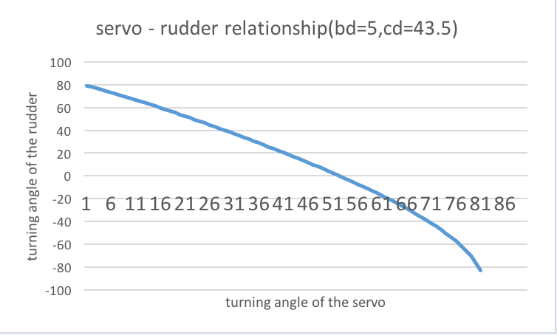
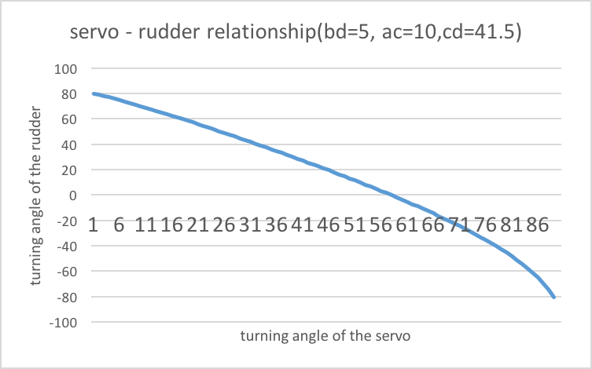
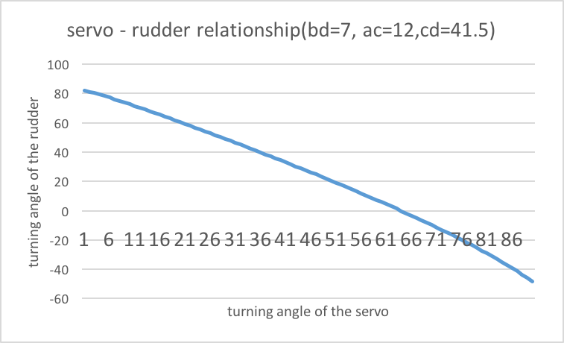
Graphs
Keqi Shu- Powertrain Engineer

Slide 9
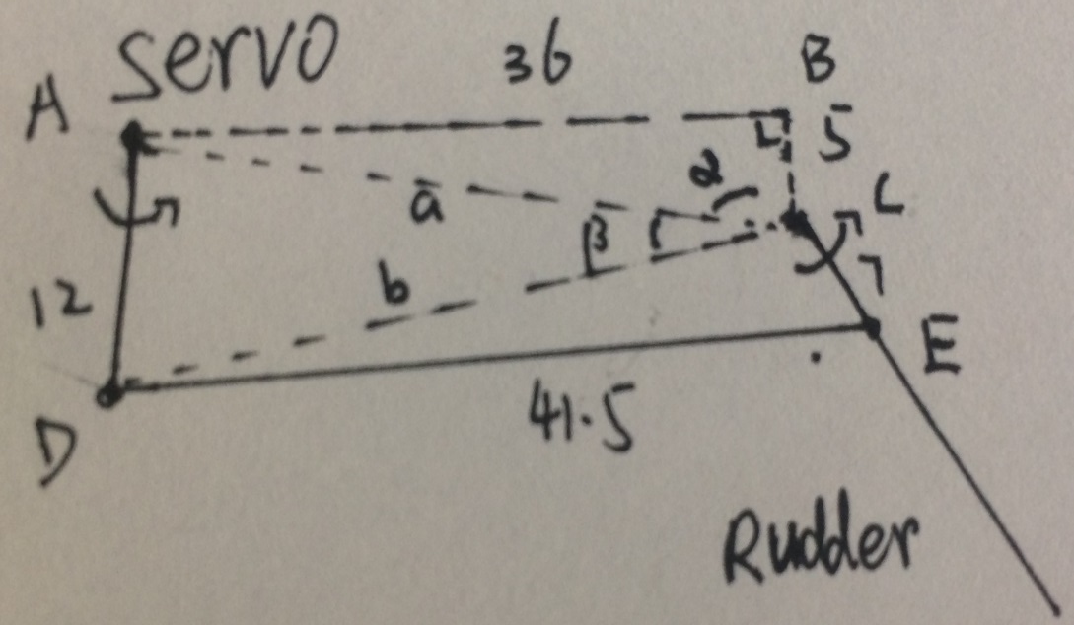
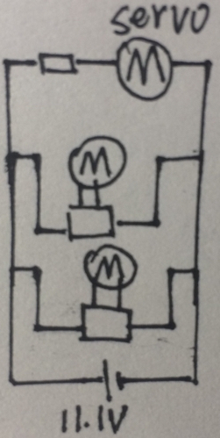
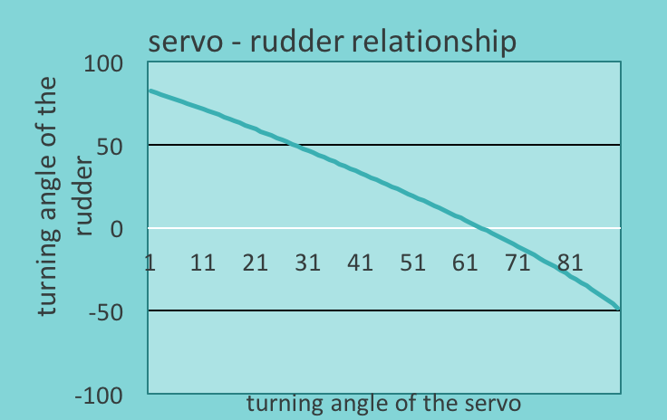
Powertrain – Final Design（as simple as possible）
Keqi Shu- Powertrain Engineer
Motor & Circuit
Study the battery & motor controller
Evaluate the torque and the turning speed under load condition.
Parallel circuit.
Power the servo by series connect a resistor.(balance the voltage)
Set up the safety ratio to 1.2.
Transmission Structure
Decided to use Linkage mechanism.
Use the most severe conditions to decided the length of links.
Use excel to know the turning angle relationship.
Change the links length and find the best solution.
Limit of servo in turning angle(strict to 100)
Turning angle difference in two sides
 | Servo | resistor | Lift | thrust | Needed (*1.2 ) | provide
Voltage(V) | 6- 7.4 | 3.7-5.1 | 12 | 6-15 |  | 11.1
Input Energy(Wh) | 0.84 | 0.9 | 5.52 | 8.54 | 18.96 | 28.8
Weight (g) | 11 | 1 | 55 | 58.8 | 125.8
torque | 20Ncm |  |  | 58.8gcm
Price(£) | 5.45 | 1 | 10.6 | 4.39 | 21.44
Calculations & Proves
P=IV, current and voltage of servo and resistor are nearly the same .
DF =3(n -1)-2n' =1
The Law of Cosines
a²=b²+c²-2bccosA etc
The Law of Sines
sinA / a = sinB / b = sinC/c

Slide 10
Bradleys Portfolio

Slide 11
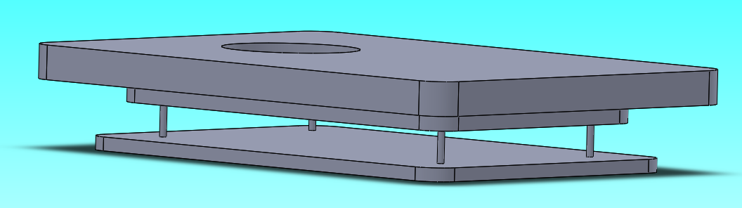
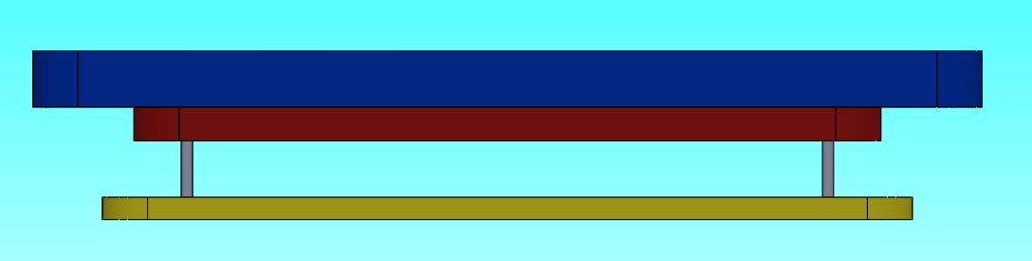
Body and Skirt – Final Design
Bradley Blocksidge – Chassis Engineer
Body
Completed Chassis
Shape
The shaped body will be roughly 418 x 295mm in size, allowing for the thickness of the skirt.
It will be a rounded rectangle shape.
Reinforcement layer
This layer will attached to the bottom of the hovercraft providing support to the structure.
Momentum Curtain
This final layer increases the velocity of the air under the hovercraft therefore increasing the pressure giving it more lift.
Chassis Layers
Shaped Top Layer
Reinforcement Layer
Momentum Curtain
Skirt
A bag skirt design will be used.
+Less material- Lighter, cheaper. +Simply design-Less time consuming.

